Slide 1
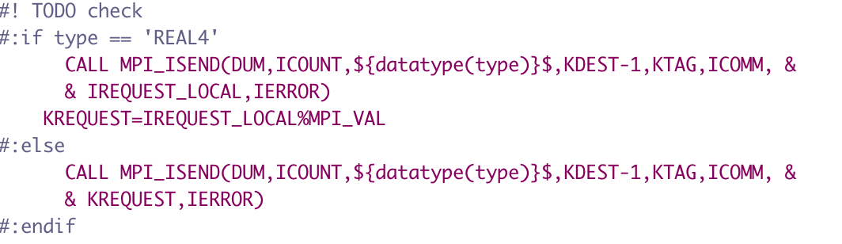
FYPP - MPL
Original work done based on CY49 branch
MPL seems to have a history of fixes around MPI bugs ; testing which are still needed
Updated to branch for internal_f08 changes made to fiat 2.0.1
Tested against ectrans, standalone tests (based on arpifs (phys))
  OpenMPI issue fixed upstream (6.0.0 interface)
  Adding test suitel
Standardised naming to match field_api RANK, SUFF
  Moved code to python-utils/ecType.py similar to field_api approach
  What modules use mpl_ outside the IAL codebase?
Different behaviour in some modules for different datatypes:
  (Appears to be relic, not needed)

Slide 2
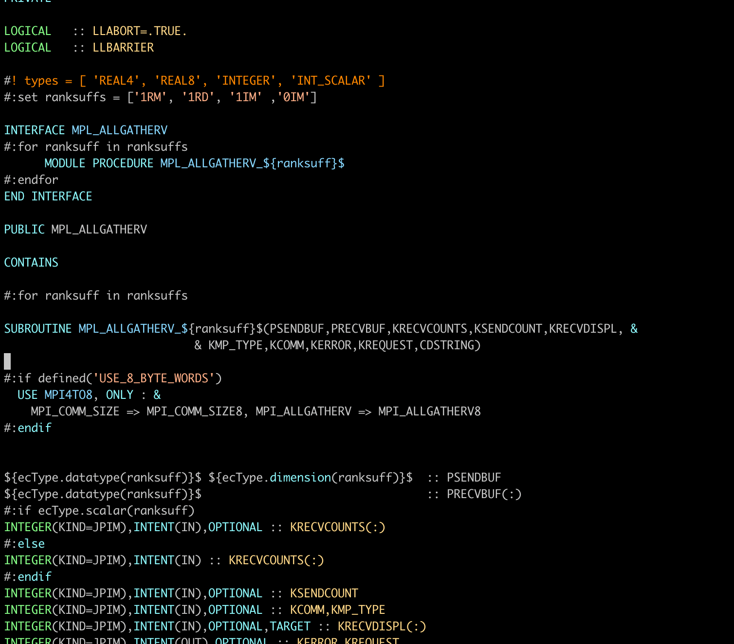
Branch:
  https://github.com/amckinstry/fiat/tree/dev-fypp
Moved fypp logic out to ecTypes.py
  Following field_api design
  Standardised method names to field_api
    (Not visible outside MPL)

Slide 3
Issues/Questions
What are the rules / plans around F90 naming conventions in IAL code:
  Eg. Variable names starting with K,P, all uppercase , etc
Renaming parameters, eg. PSENDBUF/KSENDBUF -> SENDBUF for interface
  MPI_ALLGATHER_INT (KSENDBUF,…) , MPI_ALLGATHER_REAL4(PSENDBUF,…)
    Called as MPI_ALLGATHER(KSENDBUF=X, …)
    Renaming to SENDBUF breaks interface; using P/K is misleading
What is the plan for MPL ? Currently working on design of moving to use memory allocator, but:
  Move GPU transfer code to MPL layer from ectrans?
  Status/plans for Field_api? Uses MPI directly rather than MPL.

